Slide 1
Lectures 11 and 12
Lecture 11: Topics
  Collusion
Readings
  Ethyl and Rapid Price Communication
Lecture 12: Topics
  Strategic Behavior
Readings
  Dupont and Computers

Slide 2
Notes
Laptops: use only for note taking/Canvas/Zoom
Reminder: to participate in instant polls and chats during this class, please connect to zoom via the link on Canvas (https://canvas.cmu.edu/)
Reminder: you will need to be on Canvas (https://canvas.cmu.edu/) also to complete the short assessments

Slide 3
Review
Demand and supply
Market equilibrium
Perfect competition, Monopoly, Monopolistic competition
Game theory
Oligopoly
  Cournot
  Stackelberg
  Bertrand

Slide 4
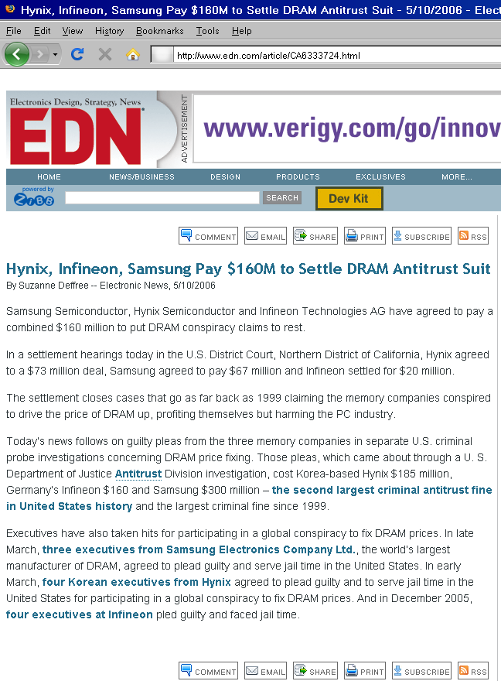
Lecture 11: Today’s Objectives
What is collusion?
Creating and maintaining collusion

Slide 5

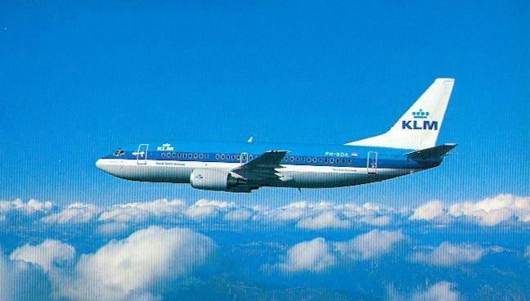
Lecture 12: Today’s Objectives
Analyze various strategies and strategic behavior that firms can adopt to keep competitors out of their markets (or get them to exit, if competitors are already in)
Analyze the causes and consequences of mergers and acquisitions

Slide 6
Collusion
What is collusion?
  In the extreme, firms act jointly as if they were a monopolist (essentially forming a “cartel”)
  More generally, firms raise prices above what they would have been in the Cournot case

Slide 7
Collusion
In the U.S., collusion is illegal under Sherman Antitrust Act (1890)
  Section 1 “Every contract, combination in the form of trust or otherwise, in restraint of trade … is declared to be illegal”
  Section 2 “Every person who shall monopolize, or attempt to monopolize, or combine or conspire with any other person or persons, to monopolize any part of the trade or commerce … shall be deemed guilty of a felony …”

Slide 8
Collusion
Explicit collusion
  E.g., Joint Executive Committee, 1880-1886
  Cartels (see next slide)
  May be feasible to prosecute based on evidence of meetings to fix prices
Tacit collusion
  Very hard to prosecute, as it may be difficult to differentiate from ‘good business practice’ and competitive behavior
    Christmas season, Oxford Street, London: Sony TV set models sold at identical prices by most sellers (significantly higher than marginal costs)
    Telecommunication auctions
    Ethyl and Rapid Price Communication are examples
  …but not always impossible to prosecute: See DRAM case, airlines, telecoms, …

Slide 9
Cartels
Even though collusion may be illegal in most countries, some (international) cartels have been successful for extended periods of time
  E.g., OPEC, or the diamond cartel
  DeBeers owns only a small share of diamond mines…
    …but its marketing arm, Central Selling Organization (CSO), used to control the processing of 80% of the world’s diamonds (nearly a monopsony)

Slide 10
De Beers and CSO
CSO regulated the diamond market, setting the prices (to achieve stability), building up stocks
  Going against CSO could be risky
    In 1981, Zaire’s President Mobutu (the world’s largest supplier of diamonds) announced that Zaire would no longer sell diamonds through CSO
    Two months later, the diamond market was flooded with one million carats diamonds that brought the price of a carat from $3 to $1.80
    Eventually, Zaire had to request a renewal of its old contract in 1983 (ended up with less favorable clauses)
x

Slide 11

The market for computer chips has the following demand curve in every period: Q = 40 – P. There are two firms, Intel and AMD, their chips are identical, and they have the same constant marginal cost = $10. The two firms can be thought of as competing on quantities (i.e. Cournot competitors).
What are q1, q2, P, and each firm's profits in this market if they compete on quantities?
What would q1, q2, P, and each firm's profits be if they could collude perfectly?
Suppose AMD knew that Intel planned to produce the collusive output. What would the optimal (profit maximizing) output be for firm AMD? What would P and each firm's profits be in this case?

Slide 12
Collusion
Collusion is profitable….
But collusion is hard to maintain
Why?
  Incentives to deviate
    Collusion may not be a Nash equilibrium
      What if you consider this a repeated game? Well, if discount rate is high enough, firms will still act in their short term interest
x

Slide 13
Collusion
Collusion is easier to maintain if
  Industry is concentrated
    Why?
  Interaction is frequent
    Why?
  Industry is growing
    Why?
  Continued interaction is likely
    Interpret this as the probability that the industry will still be around tomorrow
    Why?
      Repeated games, finite/infinite horizon
Readings: Ethyl and Rapid Price Communication

Slide 14
Strategic behavior(s)
Entry deterrence: keeping potential entrants out
  Capacity expansion
    Blockaded entry
    Limit pricing
    (Entry accommodation)
  Product proliferation
  Contracts
Predation: getting entrants (or competitors) to exit
  Predatory pricing
  Nonpricing predation
    Related: Abuse of dominant position
Competition by mergers and acquisitions

Slide 15
Strategic behavior(s)
Entry deterrence: keeping potential entrants out
  Capacity expansion
    Blockaded entry
    Limit pricing
    (Entry accommodation)
  Product proliferation
  Contracts
Predation: getting entrants (or competitors) to exit
  Predatory pricing
  Nonpricing predation
    Related: Abuse of dominant position
Competition by mergers and acquisitions

Slide 16
Mergers and acquisitions
Why mergers?
  Other way of eliminating competition…
Often mergers cause price increases
  Why?
    Cournot game where number of players goes from n to n-1
Paradox: profits from merged firm may be less than the sum of the profits from the two merging firms before the merger

Slide 17
Mergers and acquisitions
Consider the market for RAM chips, in which 6 identical firms operate and compete on quantity, choosing their production level simultaneously (Cournot game). Their products are identical. The demand curve for RAM chips is Q = 28 – P and marginal costs are (for simplicity) 0. Two of the players merge and in response the four remaining firms merge into two firms (each made up of two of the original firms) so that there are now 3 players in the game.
  What are the price, quantities, and profits before the merger?
  What is the effect of the merger on price, quantity, and profits for each firm?
  How is this different from when only two of the players merge and the other players do not merge?

Slide 18
The Paradox of Merger vs. potential advantages of mergers and acquisitions
“Merger paradox”: in a Cournot market game, mergers are generally unprofitable unless almost all firms merge
  Why? Non-merging firms “free-ride” on merger, taking advantage of reduced competition
Empirical validation?
  “Firms that are quoted on the stock markets of Western industrialized economies undertake hundreds of acquisitions (or mergers) every year. […] Curiously, the lion's share of these acquisitions repeatedly fail to create shareholder value” (Schenk, 2008)
But if so, why do so many firms still do M&A?

Slide 19
The Paradox of Merger vs. potential advantages of mergers and acquisitions
Some possible advantages of M&A were not captured in the previous model:
  Synergies
    Vertical vs. horizontal mergers
  Cost efficiencies
    E.g. cost reductions in horizontal mergers, economies of scale, economies of scope…
  Change in the competitive environment and prices
    May move the game from Cournot to Stackelberg, or collusion
  But, if pure Cournot game, p goes up and q_{i} goes up
    Combined output of merged firms often decreases
    Hence, non-merging firms often benefit the most from mergers!
    Consumers often lose from mergers

Slide 20
Mergers and acquisitions
Mergers tend to come in waves
  Exogenous events such as deregulation
  Endogenous effects such as merger of two big firms changes the payoff to other firms merging

Slide 21
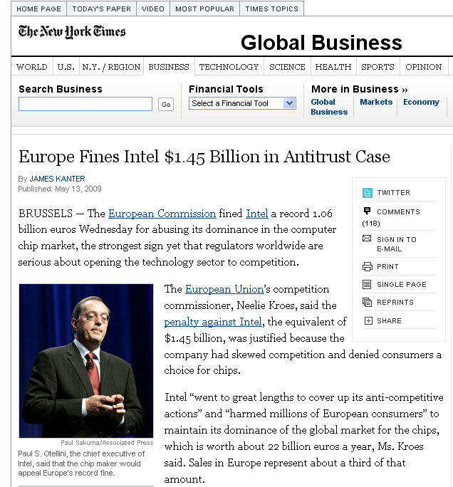
Abuse of dominant position
Ms. Kroes ordered Intel to stop offering rebates that were conditioned on buying less of a rival’s product, or not buying them at all, which she said had helped Intel maintain a share of at least 70 percent of chip sales market from October 2002 to December 2007 […]
She also said Intel made payments to some manufacturers in exchange of postponing, canceling or putting restrictions on the introduction or distribution of AMD-based products.
She said Intel also had made payments to Media Saturn Holding, the owner of the MediaMarkt chain of superstores for only selling Intel-based computers in Germany, Belgium and other countries.
http://www.nytimes.com/2009/05/14/business/global/14compete.html?_r=2&hp

Slide 22
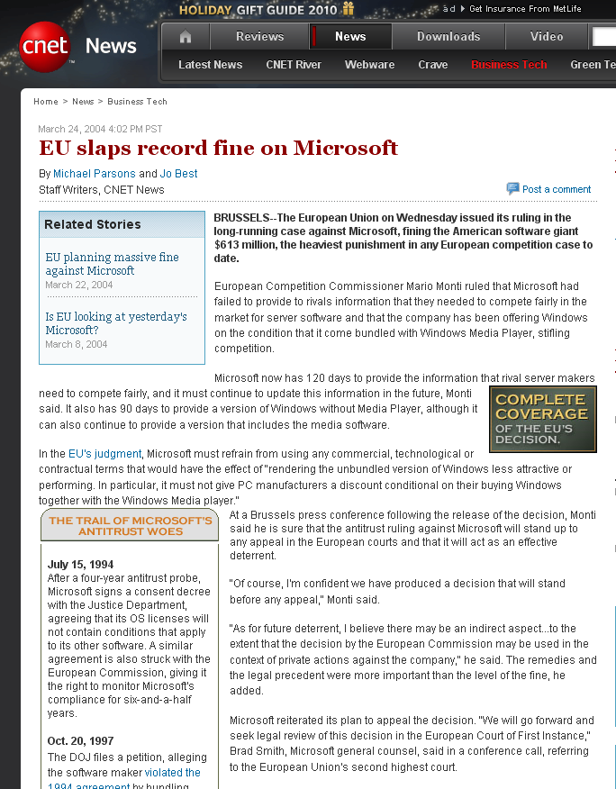
Abuse of dominant position
European Competition Commissioner Mario Monti ruled that Microsoft had failed to provide to rivals information that they needed to compete fairly in the market for server software and that the company has been offering Windows on the condition that it come bundled with Windows Media Player, stifling competition.
http://news.cnet.com/EU-slaps-record-fine-on-Microsoft/2100-1001_3-5178281.html?tag=txt

Slide 23
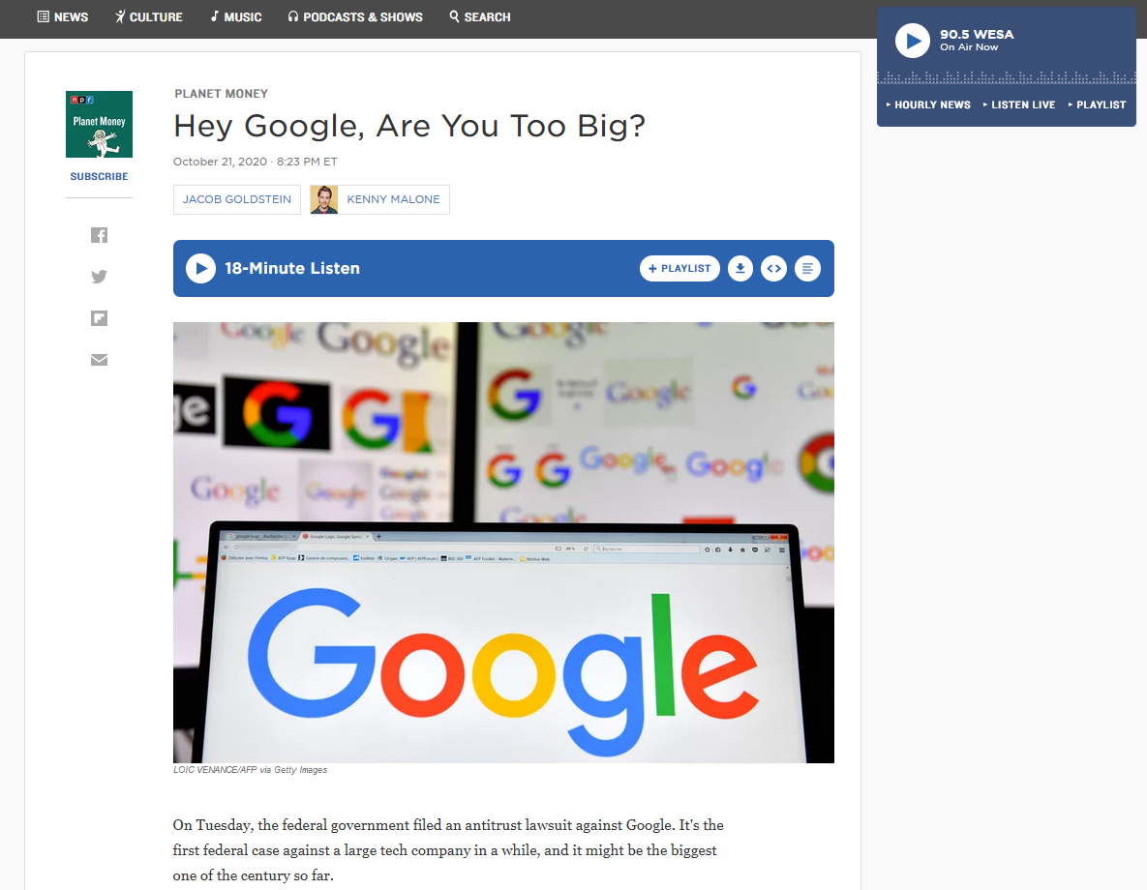
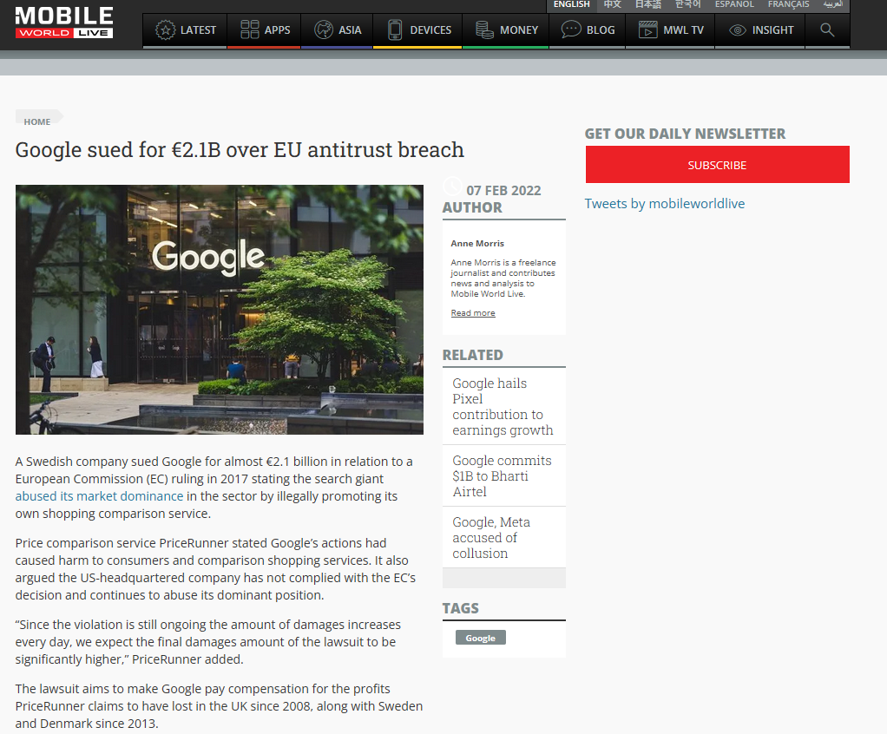

Abuse of dominant position
https://www.justice.gov/opa/pr/justice-department-sues-monopolist-google-violating-antitrust-laws

Slide 24
Draft solutions to collusion problem (TO UPDATE)
  Profit firm 1 comes from profit function Profit_1 = TR_1 – TC_1 (with “_1”, I am referring to the profit/revenue/cost for firm 1), that is p*q1 – c(q1). Replace p with inverse demand function and express profit function as: (40-q1 – q2)q1 – 10q1. Take derivative wrt to q1 and set to 0, find 30 – 2q1 – q2 = 0. Find similar reaction function for q2 by solving fro Profit_2. Solve system of two equations in two unknowns (q1 and q2) and find that get q1=q2=10. Thus, total Q is 10+10 = 20, and therefore p=20 (from inverse demand function). Calculate profit as Profit1 = p * q1 – c(q1), which is 20*10 – 10*10 = 100
  Profit for colluding group can be found by solving the model as if the two firms acted as a cartel and maximized profits for the cartel. That is: Profit = TR – TC, that is p(q1+q2)*(q1+q2) – c(q1) – c(q2). In this particular scenario, where the two firms have identical costs and the costs are linear, we can simplify this problem by setting q1+q2=Q and then solving for: (40-q1-q2) Q – 10Q . Follow the same steps above and solve for Q. You find that Q= 15. Hence we get q1=q2=7.5, p=25. Profit is 25*7.5 – 10*7.5 for each firm.
  The firm that deviates from the collusive equilibrium (eg firm 1) assumes that the other firm (eg firm 2) will produce the collusive equilibrium. The firm attempts to maximize its profit = TR – TC, that is p*q1 – c(q1). When replacing p with the inverse demand function [that is, (40-q1 – q2)] we actually replace q2 with the amount that q2 is supposed to produce under collusion: (40-q1 – 7.5). So, after we insert this inverse demand function into the profit function we get (40-q1 – 7.5) q1 – 10*q1, and after we solve for the first order condition for a maximum, we find: (40 - 7.5 - 10) = 2 q1 and therefore q1=11.25. So total quantity produced is 11.25 by firm 1 and 7.5 by firm 2. Hence equilibrium price is p=21.25. Profit is higher for firm 1 if it deviates.

Slide 25
Draft solution to merger exercise
WITH 6 firms: inverse demand function is P = 28 – q = 28 – Q1 – Q2 – Q3 – Q4 –Q5 – Q6
Profit function for firm 1 is P*Q1 = (28 – Q1 – Q2 – Q3 – Q4 –Q5 – Q6) Q1
FOC: 28 – 2Q1 – Q2 – Q3 – Q4 –Q5 – Q6=0
SIMPLIFYING, 28 = 7Q >>> Q = 4, P = 28 – 6X4 = 4, PROFIT = 16
With 3 firms: FOC: 28 – Q1^2 – Q2 – Q3 HENCE 28 = 4Q >> Q = 7, PRICE = 28 – 3X7 = 7, PROFIT = 49
With 5 firms: FOC: 28 – Q1^2 – Q2 – Q3 – Q4 –Q5 >> 28 = 6Q >>> Q = 4.67, PRICE = 28 – 5 X 4.67 = 28 – 23.35 = 4.65, PROFIT IS 4.65 * 4.67 = 21.7155

